Slide 1
ACS Quality Framework

Slide 2
Your Presenter
Karen Pollitt, CPHQ
Sr. Manager, Division of Research and Optimal Patient Care

Slide 3
Agenda
Welcome​
The Development of the ACS Quality Framework​
What is the Quality Framework? ​
Framework Components ​and Criteria
Toolkit and Other Resources​
Next Steps
ACS Quality and Safety Conference & ACS Quality Improvement Course​
Q&A
Notes:
Welcome to the Quality Framework Webinar!​ Here is our agenda for today.​
​
We will start with talking about the Framework in general: How was it developed and what is it? ​
​
We will then move into the components of the Framework​, the Framework Toolkit and other resources​, next steps, and some ACS quality improvement educational opportunities available to you.
​
​

Slide 4
The ACS Quality Framework

Slide 5
Development of the Quality Framework
ACS Quality Programs include quality improvement in their standards. However, quality improvement standards typically have the highest rate of deficiency.​
​In February 2021, a cross-College committee evaluated 50 projects from program participants to understand how quality improvement is being conducted. ​
The team found opportunities for improvement in project planning and documentation.​
​
This team developed a framework to guide hospitals in their quality improvement work.
Notes:
The ACS Quality Programs include quality improvement in their standards. However, quality improvement standards typically have the highest rate of deficiency in the accreditation/verification process. ​
​
In February 2021, a cross-College committee, led by Dr. Clifford Ko (Director, ACS Division of Research and Optimal Care), Dr. Avery Nathens (Medical Director, ACS Trauma Programs), and Dr. Heidi Nelson (Medical Director, ACS Cancer Programs), with experts from the ACS Quality Programs, was formed. This group evaluated 50 projects from program participants to understand how quality improvement is being conducted. The team went on to review an additional 1000 projects from all of the ACS Quality Programs. The studies reviewed were from 2019 pre-covid. ​
​
These reviews concluded that there are opportunities for improvement in project planning and project documentation, and this team developed a framework to guide hospitals in their quality improvement work. ​
​
​
​

Slide 6
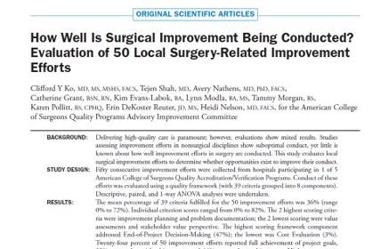
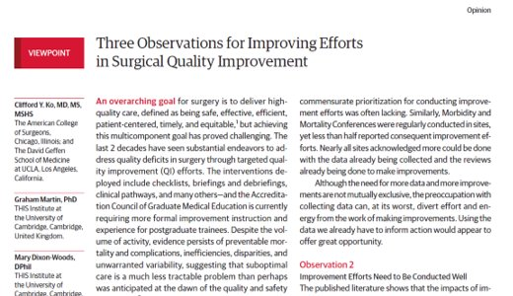
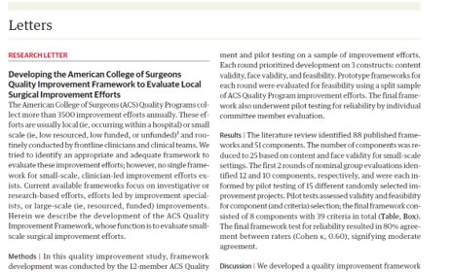
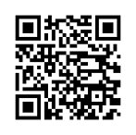
Notes:
We have published two articles and a research paper on our findings from the project review. For more information on the results of our project review and the development of Framework, we invite you to check out these publications. You can scan the QR codes on the screen to access the papers.
​
The first is titled “How Well is Surgical Improvement Being Conducted? Evaluation of 50 Local Surgery-Related Improvement Efforts”.
The second is “Three Observations for Improving Efforts in Surgical Quality Improvement” and ​finally, we have “Developing the American College of Surgeons Quality Improvement Framework to Evaluate Local Surgical Improvement Efforts”.

Slide 7
What is the Quality Framework?
Plan
Conduct
Evaluate
Report
The purpose of the Quality Framework is to improve quality improvement.
The aim is to help hospitals plan, conduct, evaluate, and report on quality improvement projects.
The Framework can:
help quality improvement teams ensure their projects are comprehensive and effective.
guide teams in writing detailed and thorough reports on their quality improvement projects.
It is a process-neutral tool that can be used to support any quality improvement methodology, such as Lean or Six Sigma.
Notes:
​
What is the framework?​
​
The purpose of the Quality Framework, or the Framework, is to improve quality improvement with the aim of helping hospitals improve their ability to plan, conduct, evaluate, and report on quality improvement projects submitted across the ACS Quality Programs. ​
​
The Framework consists of eight components with criteria that are critical to include in a quality improvement project.​
​
The Framework will help quality improvement teams ensure their projects are comprehensive and effective.​
​
It will also guide improvement teams in writing detailed and thorough reports on their quality improvement work.​
​
The Framework is not a methodology, but it can be used in tandem with any existing quality improvement methodology, such as Lean or Six Sigma.
​

Slide 8
3 Types of Quality Improvement Initiatives
Large-Scale Improvements | Small-Scale Improvements | Individual-Scale Improvements
Published in NEJM, JAMA Well-funded, well-resourced Often have trained experts to lead the efforts IRB-approved initiatives | Local efforts, e.g., what works at an academic setting doesn’t work at a community hospital) Usually within a service line, group of surgeons, type of operations Not an initiative across the entire hospital Usually led by surgeons, quality improvement professionals, program staff | Self-improvement initiatives, e.g., related to surgical techniques, use of HER, etc. No data collection
Notes:
There are 3 types of quality improvement initiatives​.
​
There are large-scale improvement efforts, such as the national opioid studies, which require IRB approval. These tend to be published, well-funded, well-resourced and often include trained experts to lead the team.​
There are the small-scale improvement efforts which focus on a local issue. They normally do not include the entire hospital and are conducted within a service line or by operation type. They are usually led by a physician who can affect change.
​
Lastly, there are individual-scale improvement efforts. These typically do not include data collection and focus on individual improvements, such as improving surgical technique for robotic surgery.​

Slide 9
3 Types of Quality Improvement Initiatives
Large-Scale Improvements | Small-Scale Improvements | Individual-Scale Improvements
Published in NEJM, JAMA Well-funded, well-resourced Often have trained experts to lead the efforts IRB-approved initiatives | Local efforts, e.g., what works at an academic setting doesn’t work at a community hospital) Usually within a service line, group of surgeons, type of operations Not an initiative across the entire hospital Usually led by surgeons, quality improvement professionals, program staff | Self-improvement initiatives, e.g., related to surgical techniques, use of HER, etc. No data collection
Notes:
The projects submitted to the ACS typically fall into these small-scale improvement efforts. ​
​
They concentrate on a local issue, are performed by internal staff, typically without funding. ​
​
Local efforts involve issues such as: ​
​
Wait time for Pediatric surgical patients from admission to hospital bed​
Geriatric surgical patients not being screened for medication needs prior to surgery​
Inconsistent screening of Cancer patients for smoking ​
Inconsistent medical documentation in the EMR​
Low turn out for Bariatric support group sessions

Slide 10
Framework Components & Criteria
Notes:
Let’s dive a little deeper into the Framework itself.

Slide 11
Eight Components of the Framework
Planning
Conducting
Reflecting
Problem Detailing
Aim Specification
Strategic Planning
Knowledge Acquisition
End-of-Project Decision-Making
Process Evaluation
Outcome Evaluation
Cost Evaluation
Notes:
​The Framework consists of eight components with associated criteria and is organized around the three phases of a quality improvement project – Planning, Conducting and Reflecting. ​
​
The Planning Phase is where you determine your local issue, develop your implementation plan and decide the strategies you will use to put your plan in place. This phase contains the components of Problem Detailing, Aim Specification and Strategic Planning.​
​
The Conducting Phase is where you develop a plan of action to successfully implement your project, evaluate your results, and determine the value of your project after implementation. The components in this phase are Process Evaluation, Outcome Evaluation and Cost Evaluation. ​
​
The Reflection Phase is where you share your results, lessons learned, and determine the long-term plans for your project as well as solidify your sustainability plan. The reflection phase encompasses the Knowledge Acquisition and End-of-Project Decision Making components.

Slide 12
Project Planning
Planning
Conducting
Reflecting
Projects are more successful when they include:
​
Utilization of project management tools
Clearly assigned accountability of all tasks
Specific and measurable aims
Robust communication ​
​
Donnelly LF. Avoiding failure: tools for successful and sustainable quality-improvement projects. Pediatr Radiol. 2017; 47: 793-797. doi: 10.1007/s00247-017-3823-z
Notes:
Today, let's explore the Project Planning phase. ​
​
Research has shown that projects are more successful when they include utilization of project management tools, clearly assigned accountability of all tasks, specific and measurable aims, and robust communication. Let’s explore each of these a bit. ​
​
Utilization of project management tools: Collaboratively using project management tools, such as a project charter, throughout the duration of a project helps to ensure that all critical steps of a project are completed and that a clear, unified vision is agreed upon by all team members and stakeholders.
Clearly assigned accountability of all tasks: In a successful project, it is clear who owns each task or deliverable.
​
Specific and measurable aims: Clearly defined aims give the project direction and help to avoid scope creep.
​​
Robust communication: The team should communicate with team members, stakeholders, committee members and others throughout the project, and they should have a plan for when and how they want to do that. For example, there should be regular, scheduled meetings with team members; there should be a plan for communication outside of these meetings, such as a team chat, to discuss any concerns that might arise.​
​

Slide 13
Project Planning
Planning
Conducting
Reflecting
Project planning plays an essential role in helping you guide your team and stakeholders though all project phases. ​
​
Identify your local issue​
Determine project aim​
Select evaluation methods​
Develop timelines​
Determine resource needs​
Identify potential problems and solutions
Notes:
Project planning is the starting and ending point of your project. It plays an essential role in helping to guide the team, stakeholders and others through all project phases.​
​
For a project to be successful, it is essential to:​
​
Identify your local issue: Where is the issue taking place locally?​
Determine your aim: What are you trying to improve, and how much?​
Select your evaluation methods: How will you evaluate your progress and monitor your results? What data will you need?​
Develop your timeline: How long do you anticipate it will take to meet your aim?​
Determine your resource needs: Who/What do you need to achieve success?​
Identify potential problems and solutions: Are there any possible barriers to your project success? If so, what can you do to prevent them from happening?​
​
The Planning Phase contains the first three components in the Quality Framework. ​
​
Next, we would like to talk about these components in detail.

Slide 14
Components 1, 2, & 3 and Criteria
Component #1: Problem Detailing | Component #2: Aim Specification | Component #3: Strategic Planning
1.1 Local Issue 1.2 Problem Statement 1.3 Baseline Data 1.4 Local Impact 1.5 Patient Input 1.6 Improvement Team 1.7 Internal Stakeholders 1.8 External Stakeholders | 2.1 Specific 2.2 Measurable 2.3 Achievable 2.4 Relevant 2.5 Timely | 3.1 Existing Research 3.2 Description of Intervention 3.3 Intervention Rationale 3.4 Description of Implementation Strategies 3.5 Implementation Strategies Rationale 3.6 Stakeholder Involvement 3.7 Intervention Resources 3.8 Implementation Strategy Resources 3.9 Intervention Data 3.10 Possible Limitations and Challenges of the Intervention
Notes:
Here is a list of the first 3 components and their criteria.
​
As you can see, the Problem Detailing component has eight criteria that covers elements such as identifying your local issue, gathering baseline data and determining your stakeholders.​
​
The Aim Specification Component has 5 criteria. This component asks you to identify your goal in the SMART format (Specific, Measurable, Achievable, Relevant and Timely). ​
​
Component #3 is Strategic Planning. This component has 10 criteria and covers areas such as describing your intervention and rationale, your implementation strategies, your implementation data and identifying possible limitations and challenges in your project.​
​
Next, we will look more closely at these first three components, and we will take a look at a specific criterion within each of them.​
​

Slide 15
Component #1: Problem Detailing
Problem Detailing
Aim Specification
Strategic Planning
Planning
Conducting
Reflecting
Problem is clearly defined and understood ​
Establishes why the existing gap in care or process is important​
Ensures your team has analyzed the who, where, when, what, and how of the problem at a local level​
Involves the perspectives from all key stakeholders
Notes:
Problem Detailing is the first component. This is essential to your project’s success as this is where your problem is clearly defined and understood. ​
​
It establishes why the existing gap in care or process is important. ​
​
Completing the criteria in this component will ensure your team has analyzed the who, where, when, what, and how of the problem at a local level, and it involves the perspectives of all key stakeholders.​
​
A well-defined problem statement helps to establish a clear direction for the project. It identifies the specific issue or challenge that needs to be addressed, ensuring that the project team's efforts are concentrated on the right problem, which in turn guides teams to be sure that QI activities are focused on the desired improvement. ​

Slide 16
Component #1: Problem Detailing
Criterion 1.8 External Stakeholders:​
Explain how your team evaluated the need for any external stakeholders.
List any external stakeholders deemed necessary for the project (e.g., payer, consultants, collaboratives, and partner organizations). Explain why these external stakeholders are relevant to the project.
If your team deemed external stakeholders unnecessary to the project’s success, explain why.
Example Statement 1
Key stakeholders at Hospital X were identified within pediatric gastroenterology, pediatric nutrition, inpatient pediatrics, neonatology, and nursing.
The local pediatric rehabilitation facility was also included in the planning due to their large feeding program and referrals for GT placement.
Example Statement 2
Key stakeholders at Hospital X were identified within pediatric gastroenterology, pediatric nutrition, inpatient pediatrics, neonatology, and nursing.
Notes:
So let’s take a look at one of the criteria in the Problem Detailing component. We’ll use Criterion 1.8, External Stakeholders, as an example. It asks for an explanation of how the team evaluated the need for any external stakeholders. As a part of the explanation, it asks for teams to list any external stakeholders and explain why they are relevant to the project. It also asks for teams to provide an explanation as to why external stakeholders may have been deemed unnecessary to the project’s success.
​
Here are two examples of statements describing the local impact. ​
​
Example Statement 1 says “Key stakeholders at Hospital X were identified within pediatric gastroenterology, pediatric nutrition, inpatient pediatrics, neonatology, and nursing. The local pediatric rehabilitation facility was also included in the planning due to their large feeding program and referrals for GT placement.” As you can see, the first statement is specific. It indicates that the team involved an external facility in the planning, and it explains why the facility was included in the list of external stakeholders. ​
​
Now let’s look at Example Statement 2, “Key stakeholders at Hospital X were identified within pediatric gastroenterology, pediatric nutrition, inpatient pediatrics, neonatology, and nursing.” In the second statement, we are missing evidence that the team truly evaluated whether or not external stakeholders are necessary for their project.
​
Even though external stakeholders are not directly involved, they can bring broader perspectives and knowledge to the table, which can help identify potential barriers or help secure additional resources. Including an explanation as to why or why not external stakeholders are included helps teams to evaluate the need for them.

Slide 17
Component #2: Aim Specification
Problem Detailing
Aim Specification
Strategic Planning
Planning
Conducting
Reflecting
​Includes input from all relevant stakeholders ​
Follows the SMART (specific, measurable, achievable, relevant, and timely) goal format​
Describes your project goals and makes them understandable to clinical teams and leadership​
Guides your work by establishing a benchmark for success​
Keeps the team focused, accountable, and motivated
Notes:
Component 2 is Aim specification. Creating an aim statement is an excellent way to help you clarify and define the goal of your project. ​
​
Your aim statement should include input from all relevant stakeholders and follow the SMART, that is, specific, measurable, achievable, relevant, and timely, goal format. ​
​
An impactful aim statement succinctly describes your project goals and makes them understandable to clinical teams and leadership. ​
​
It also guides your work by establishing a benchmark for success, and keeps the team focused, accountable, and motivated.​
​

Slide 18
Component #2: Aim Specification
Criterion 2.2 Measurable:​
State the numerical or percentage value of the outcome measure(s) that your project intends to achieve.
Example Statement 1
Our aim is to reduce the overall incidence of CAUTIs by 50% from our 2022 baseline of 135 by June 30, 2023, and continue to reduce CAUTIs by 50% each subsequent year.
Example Statement 2
Our aim is to reduce the overall incidence of CAUTIs within 1 year.
Notes:
Here is an example of a criterion in the Aim Specification Component.​
​
I mentioned the SMART goals format in the previous slide. This criterion, 2.2 is the M – Measurable, part of a smart goal. Here you are asked to state the numerical or percentage value of the outcome measure(s) that your project intends to achieve. ​
​
Let’s begin by looking once again at Example Statement 1. “Our aim is to reduce the overall incidence of CAUTIs by 50% from our 2022 baseline of 135 by June 30, 2023, and continue to reduce CAUTI’s by 50% each subsequent year.” This is very specific as what they want to achieve and when – reduce CAUTIs by 50% from our baseline of 135 by June 30, 2022, and continue to reduce each subsequent year. ​
​
Now let’s look at the second statement. “Our aim is to reduce the overall incidence of CAUTIs with 1 year.”​ This statement only indicates they want to reduce CAUTIs – it does not include a baseline measure or goal, nor does it provide a specific timeline.​
​
Having a specific goal with a baseline measurement and target goal is essential to measuring your success. While having a timeline keeps you on track, it also helps you plan for the appropriate amount of time needed to achieve your team’s desired results.

Slide 19
Component #3: Strategic Planning
Problem Detailing
Aim Specification
Strategic Planning
Planning
Conducting
Reflecting
​Identifies all the components of your intervention ​
Strategizes how to encourage adoption of the intervention in your local context​
Clarifying your rationale helps you prepare for key discussion with stakeholders ​
Anticipates the resources you will need to be successful
Notes:
Component 3 is strategic planning, What is strategic planning?​
​
The strategic plan is your blueprint for carrying out a successful improvement intervention. ​
​
In addition to identifying all the components of your intervention, your team should also strategize about how to encourage adoption of the intervention in your local context. ​
​
Clarifying your rationale for these decisions helps you prepare for key discussion with stakeholders and anticipate the resources you will need to be successful.

Slide 20
Component #3: Strategic Planning
Criterion 3.6 Stakeholder Involvement:​
Explain your strategy to gather stakeholder input throughout the project in relation to the intervention and implementation strategies. Make sure to include:
All stakeholders involved in the intervention and implementation strategies
How your team will communicate with stakeholders regarding the intervention and implementation strategies
Example Statement 1
Please see Communication Plan.
Example Statement 2
Dates reported to frontline staff: 05/11/21, 05/21/21, 06/17/21, 08/25/21
Notes:
Here is an example of a criterion in the Strategic Planning component. ​
​
Criterion 3.6 is stakeholder involvement. We all know how important stakeholders are to a projects’ success. ​Your team is more likely to gain buy in, acquire resources and sustain the change if you are strategic about when, where, and how you engage your stakeholders.
Let’s read through this criterion’s definition. It says “Explain your strategy to gather stakeholder input throughout the project in relation to the intervention and implementation strategies. Make sure to include:
All stakeholders involved in the intervention and implementation strategies
How your team will communicate with stakeholders regarding the intervention and implementation strategies
In our first example, the team used a communication plan. Utilizing a communication plan is an excellent way to document your stakeholder groups, goal of the communication, method of communication and timelines.​ Here at ACS, we have developed a comprehensive communication plan to help your team document your communication throughout your projects. We will discuss this further later in this presentation.
​​
In the second example, having dates is important, but we are unsure of what information the frontline staff received. In addition, we are unsure if any other stakeholder groups received this update.​

Slide 21
Eight Components of the Framework
Planning
Conducting
Reflecting
Problem Detailing
Aim Specification
Strategic Planning
Knowledge Acquisition
End-of-Project Decision-Making
Process Evaluation
Outcome Evaluation
Cost Evaluation
Notes:
As we mentioned earlier, there are three phases of quality improvement. ​
​
Today, we covered the planning phase.​
​
We are releasing the three components that fall in the planning phase first, as we believe that successful execution of these components creates a strong foundation for achieving success in the additional Framework components. ​
​
We have plans to create education on the remaining components in both the conducting and reflecting phases. So, stay tuned!​
​
​
​
​

Slide 22
More About the Framework
Notes:
Now that we’ve seen parts of the actual Framework, let’s look at some of the other tools you will have access to, as well as the benefits of using the Framework.

Slide 23
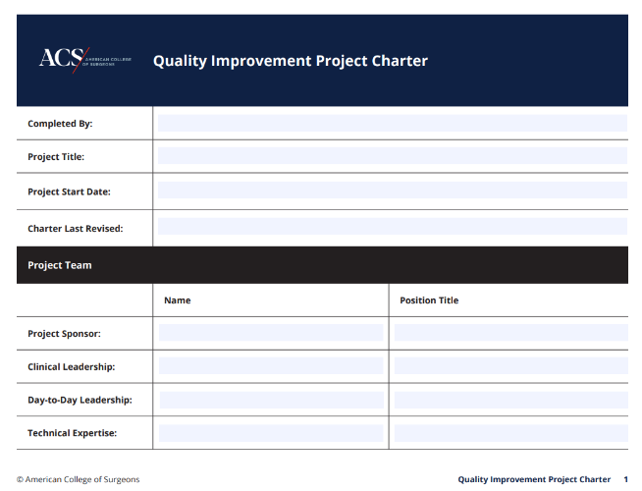
The Quality Framework Toolkit
ACS Quality Framework Submission Form​
Project Charter ​
Communication Plan ​
Data Plan
Not featured: The ACS Quality Framework Submission Form
Notes:
We have created a toolkit of quality improvement resources to complement the Framework​. Everything listed here will be available to you in the coming weeks. ​
​
The ACS Quality Submission Form is a fillable PDF for you to document quality improvement projects. This is NOT required by the accreditation/verification programs at this time. It is intended to guide you through the Framework and your project. Upon completing this form, we encourage you to submit your form to the college. We intend to use submitted projects to continue to improve the Framework for completeness and accuracy, so your participation in this initiative is greatly appreciated!
The Project Charter is a document that defines the objectives, scope, and stakeholders of a project. It provides a roadmap for the team to follow. It is the foundation of a successful project, offering clarity and direction to the team and ensuring everyone is on the same page. ​
The Communication Plan defines what information should be communicated, who should receive it, when it should be delivered, how it should be shared (i.e., email) and how the communications will be tracked and analyzed. ​
The Data Plan is a document that describes the data you expect collect, how you will manage, describe, analyze, and store the data, and what mechanisms you will use at the end of your project to share and preserve your data. ​
​
Again, use of the Framework and the tools are encouraged but not required. ​

Slide 24
The Quality Framework – What’s in it for Me?
By using the Quality Framework and using these resources to develop your projects, you will:​
​
Have an evidence-based and replicable framework to reference for future improvement initiatives​
Increase credibility for local quality improvement efforts at your institution​
Contribute to the body of knowledge for small-scale quality improvement projects​
Gain support and buy-in for your quality improvement work​
Help ACS discover common barriers that can be addressed through further education​
Give feedback that will improve ACS quality resources and support
Notes:
So, what’s in it for you? Why should you use the Framework? ​
​
By using the Quality Framework and using these resources to develop your project, you will have an evidence-based and replicable framework to reference for future improvement initiatives. You will also​ increase credibility for local quality improvement efforts at your institution​. You’ll help by contributing to a library of knowledge for small-scale quality improvement projects. By using the Framework, you will also gain support and buy-in for your quality improvement work​.
Additionally, by utilizing the Framework and the Toolkit, you will help us discover common barriers that can be addressed through further education​, and your feedback will improve ACS quality improvement resources and support.

Slide 25
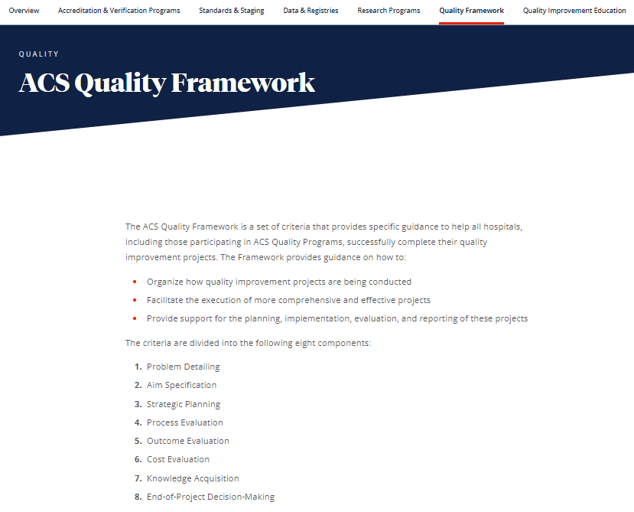
Next Steps
The Framework will be available beginning next month
Education Strategies ​
Webinars​
Alignment with the Basics Course​
ACS Quality Framework Overview Module
We want your feedback!
Notes:
So, what are the next steps? How will you access the Quality Framework and Toolkit, and what can you expect from us?
The Framework will be fully available beginning next month. All of these resources will be added to your QPort menu. If you do not have access to QPort, you will also be able to access the Framework by visiting the Quality Framework page ​on the ACS website.
We encourage you to use the Framework on your next project, and we are here to support you! Keep in mind that the Framework is intended to be used throughout an entire project. While we encourage you to look through the whole Framework, do not try to achieve everything at once; it is a process; be iterative; take your time.​
​
We will be offering additional webinars and educational resources in the coming months. Look out for more webinars, information about how the Framework aligns with our online QI Basics course, and educational modules that offer a deeper dive into each criterion.
​
Along with the Framework you will receive a Feedback Survey. After spending some time looking through and using the Framework and the tools, we encourage you to provide us with feedback – what works, what doesn’t work, what do you like, what don’t you like, what is missing, etc. This will help us with future iterations and it will help us to identify additional resources and educational opportunities. Our aim is to make this work for you! ​

Slide 26
Other ACS Quality Improvement Resources
Notes:
As we close out, we'd like to highlight a few other Quality Improvement resources available​ to you.

Slide 27
QI Basics Preconference Workshop
July 9-10 | Minneapolis, MN
Based on the self-paced, online ACS Quality Improvement Course: The Basics ​
Has a hands-on approach, complete with discussions and activities
Includes practical strategies for overcoming common obstacles
Reviews the fundamentals of the major components of quality improvement projects
Notes:
The ACS Quality and Safety conference offers a fantastic educational opportunity in the QI Basics Preconference Workshop being held on ​Sunday July 9, from 12:30 pm to 4:30 pm and Monday July 10, from 8:00 am to 12:00 pm.
​
This is based on the self-paced, online ACS Quality Improvement Course: The Basics. ​It is a guided and hands-on approach; complete with discussions and activities. ​You will learn practical strategies for overcoming common obstacles, the fundamentals of​ the major components of quality improvement projects like QI methodology, the use of data, the ​
importance of teamwork, and stakeholder engagement.​

Slide 28
QI Basics Residents Preconference Workshop
July 9-10 | Minneapolis, MN
Offered for the first time at the 2023 Quality and Safety Conference
Based on the ACS Quality Improvement Course and optimized for a resident audience
Includes the fundamentals of the quality improvement process such as how to select project measures, how to gain stakeholder buy-in
Incorporates hands-on activities with examples of real resident-driven quality improvement projects
Notes:
​The QI Basics Preconference Workshop for Residents will be offered for the first time at the 2023 Quality and Safety Conference. It will run at the same times as the basics workshop, and it is an adapted version of the ACS Quality Improvement Course optimized for a resident audience.​
​
Residents will learn the fundamentals of the quality improvement process, including how to select project measures, evaluate context, assemble a team, and gain stakeholder buy-in for a project. The workshop is filled with hands-on activities with examples of real resident-driven quality improvement projects.​

Slide 29
ACS Quality and Safety Conference Sessions
ACS Quality Framework: Lessons Learned in Year 1
Monday, July 10 4:15-5:30pm
ACS Quality Framework 101
Wednesday, July 12 9:45-11:00am
Learn the Eight Steps to Conduct a Cancer QI Project
Wednesday, July 12 12:30-1:45pm
ACS Quality Framework: From Theory to Practice
Wednesday, July 12 2:15-3:30pm
Notes:
We have four great conference sessions focused on the Quality Framework!​
​
ACS Quality Framework: Lessons Learned in Year 1​
This session will provide an overview on the development of the new ACS Quality Framework, which guides users through the steps of planning, implementing, and evaluating a successful quality improvement project at the local level. Attendees will learn more about stakeholder perspectives on quality improvement and why use of the framework is critical for the success of your next QI project.​
​
ACS Quality Framework 101​
This session will use detailed examples to illustrate the components and criteria of the new ACS Quality Framework. Attendees will learn the value of implementing quality improvement projects at the programmatic level and successful strategies to overcome common challenges in planning QI projects. They will also learn how to apply the Quality Framework toolkit to ensure their project’s success.​
​
Learn the Eight Steps to Conduct a Cancer QI Project​
This session will provide an introductory overview of the ACS Quality Framework which can help programs plan and execute a well-designed QI Project. Panelists will provide real world examples of how they moved through each of the steps when designing their projects. It is highly recommended you attend the ACS Quality Framework 101 session for a general overview of the Framework prior to this session.​
​
ACS Quality Framework: From Theory to Practice​
This is an interactive session, a hands-on opportunity to apply the ACS Quality Framework. Working in teams, participants will utilize the framework and supporting tools to develop a QI project based on programmatic scenarios with the opportunity for coaching by ACS Framework staff.​
​
​
​
​
​

Slide 30
ACS Quality and Safety Conference
July 10-13, 2023 | Minneapolis, MN
Register now! Learn about the latest developments in quality and safety, best practices and actionable items that you can implement in your own institutions!
Notes:
The Quality and Safety Conference will be held in Minneapolis, MN from July 10-13.​ We invite you to register for the Quality and Safety Conference now so you can attend these sessions !​
​
You will also have the opportunity to learn about the latest developments in quality and safety​, best practices, and you will leave with actionable items that you can implement in your own institution​.

Slide 31
The ACS Quality Improvement Course: The Basics is designed to ensure the surgical workforce and other quality improvement staff are well-educated on the basic principles of surgical quality and safety.​
The course includes six modules:​
Introduction to Quality Improvement​
The Quality Improvement Process​
Data Measurement and Analysis​
Change Management​
Patient Safety​
Leadership and Teamwork for QI​
PLUS​
Knowledge check questions, workbook activities, interactive infographics and application activities, summary videos, tools, and resources.​ We estimate that it will take about 20 hours to complete the self-paced course, accompanying workbook, and exam.​
The self-paced course costs $249 and is eligible for CME/CNE credit
Notes:
The ACS Quality Improvement Course: The Basics is also offered on-line. The course includes six modules:​
​
Introduction to Quality Improvement ​
The Quality Improvement Process​
Data Measurement and Analysis​
Change Management​
Patient Safety ​
Leadership and Teamwork​
​
It also offers knowledge check questions, workbook activities, interactive infographics and application activities, summary videos, tools and resources. It is estimated to take about 20 hours to complete the self based course, accompanying workbook and exam.​
​
The course costs $249 and is eligible for CME/CNE credit​. We encourage you to register now for this wonderful resource!

Slide 32
Also Available on the ACS Website
Quality Improvement Education: This page on our website has information about all the educational resources that we have created to help equip you with the knowledge and skills needed to start on the path towards quality improvement.
Coming soon! Case Study Repository: A collection of quality improvement projects
Notes:
We have a Quality Education page on the ACS website with these resources and other quality improvement materials. We encourage you to check it out!
​
We will also be offering another resource to help with planning your project, the Case Study Repository, which is a collection of quality improvement projects submitted by program participants. This is great resources for you to review when you are looking for direction or ideas for your quality improvement project or would like to review projects from planning stage to the end of project decision making. Stay tuned!

Slide 33
Additional Questions?
For further assistance, please contact ACSQualityFramework@facs.org.
Notes:
I recognize this short overview likely prompts questions. On your screen is our email address; please direct any questions there.
In the meantime a few that come to my mind are:
​
Is the framework required for site visit? No, it is not a requirement. The Framework is a tool to provide guidance in your quality improvement work.​
​
Is there a fee? No, there is not a fee. The framework is a free resource from the College. ​
​
When can we start using the Framework? As soon as the Framework and resources are available, we encourage you to review the materials and begin using the framework when you are ready!​
Again, watch the website for more details and thank you for your time!

Slide 34
Thank you!
Notes:
Thank you very much for your attention during this short preview of the Quality Framework.
Again for more information please contact us at ACSQualityFramework@facs.org
​

